Slide 1
FUNDAMENTALS OF MANAGEMENT
What do Beaunit Mills, Hercules Powder,
And Liebmann Breweries have in common?
On 1st Fortune List (1955)
They Don’t Exist Today
“BAD Management”
Not “Keeping up the Good Work”
Not adapting to Environmental Changes

Slide 2
Management Defined
According to Mary Parker Follett Management
is the “art of getting things done through
people”.
It Is the process of designing and maintaining
an environment in which individuals,
working, together in groups efficiently
accomplish selected aims.

Slide 3
Continued
George R Terry :- defines management as a process
consisting of planning organizing actuating and
controlling, performed to determine and
accomplish the objectives by the use of people
and resources.
Management:
Applies to any kind of organization.
Applies to managers at all organizational levels
Managers carry out the functions of planning and other functions
Is concerned with productivity; implies effectiveness and efficiency

Slide 4
CHARACTERISTICS
Is a universal activity
Is a dynamic process
Is goal oriented
It is a group activity
Is a science as well as an art
Management is a system of authority
Management involves decision making
Draws ideas and concepts from various disciplines

Slide 5
ORGANIZATION
A systematic arrangement of people brought together to accomplish some specific purpose; applies to all organizations—for-profit as well as not-for-profit organizations.
Where managers work (manage)
Common characteristics
Goals
Structure
People

Slide 6
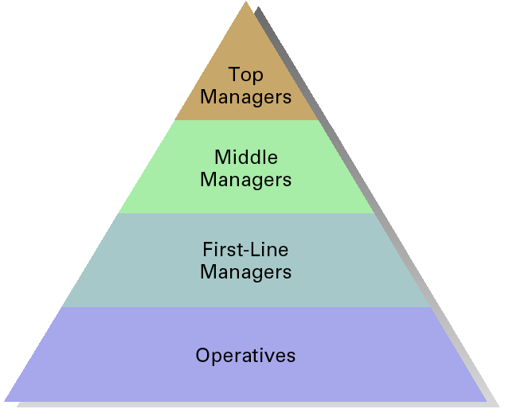
Organizational Levels

Slide 7
Identifying Managers
First-line managers
Supervisors responsible for directing the day-to-day activities of operative employees
Middle managers
Individuals at levels of management between the first-line manager and top management
Top managers
Individuals who are responsible for making decisions about the direction of the organization and establishing policies that affect all organizational members

Slide 8
Managerial functions at different Organization Levels
All managers carry out managerial functions, the time spent for each function may differ.
Top level managers, spend more time on planning and organizing than do lower- level managers.
The scope of authority held may vary and the types of problems dealt with may be considerably different.
Also, the person in a managerial role may be directing people in the sales, engineering, or finance department.

Slide 9
FUNCTIONS OF MANAGEMENT
The concepts, principles, theory and
techniques of management are grouped into
five functions as:
Planning
Organizing
Staffing
Leading
Controlling

Slide 10
MANAGEMENT SKILLS
Conceptual Skills : cognitive ability to see the organization as a whole and the relationship among its parts
Human Skills : ability to work with and through other people and to work effectively as a group member
Technical Skills : understanding of and proficiency in the performance of specific tasks.
Design Skills: Is the ability to solve problems in ways that will benefit the enterprise

Slide 11
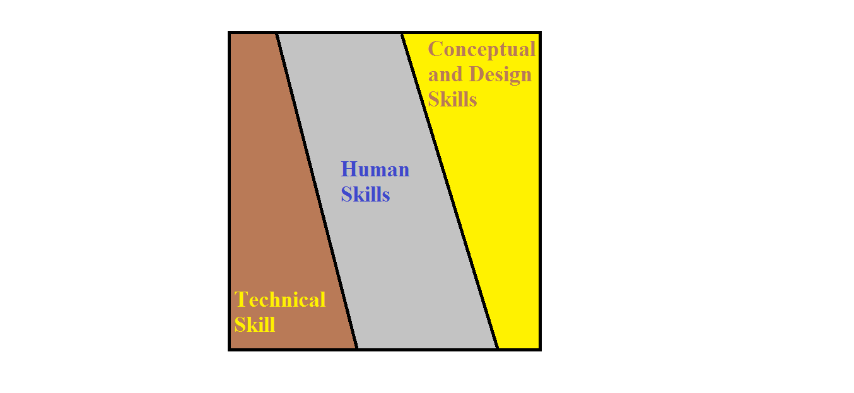
SKILLS AT MANAGERIAL LEVELS

Slide 12
MINTZBERG’S MANAGERIAL ROLES
Interpersonal
Informational
Decisional

Slide 13
Interpersonal Roles
The figurehead engages in ceremonial
activities.
The leader motivates, communicates, and influences subordinates.
The liaison develops relationships outside his/her unit both inside and outside the organization.

Slide 14
:
INFORMATION ROLES
The monitor seeks current information from many sources.
The disseminator transmits information to others both inside and outside the organization.
The spokesperson provides official statements to people outside the organization about company policies, actions, or plans.

Slide 15
Decisional Roles
The entrepreneur initiates change.
The resource allocator allocates resources to achieve outcomes.
The negotiator bargains for his/her unit.
The disturbance handler resolves conflicts.

Slide 16
Henry Fayol’s Fourteen Principles Of Management
Division of work
Authority and Responsibility
Discipline
Unity of command
Unity of direction
Subordination of the individual interest to organizational interest.
Remuneration

Slide 17
Principles Continued
Centralization
Scalar chain
Order
Equity
Stability of tenure of personnel
Initiative
Esprit de corps

Slide 18
Classifying managers
Manager is any one, at any level of the organization who directs the efforts of other
People in accomplishing goals.
Classification:
I. According to their level in the organization
As top, middle and first line
II. Line managers and staff managers
line managers are those who are directly responsible for functions or activities central to creating the main product line or service that the organization markets.

Slide 19
Contd…
Staff managers are those who in various ways support the work of line operations.
Examples: accounts, finance, legal etc.
III. Functional managers and general managers
functional manager is responsible for one type of activity like finance, personnel or marketing.
General manager is one who is responsible for all of the activities of a corporation or one or more of it’s complex subunits.

Slide 20
Contd…
IV. On the basis of their responsibilities:
1. technical
Responsible for technical activities in the organization
2. administrative
For guiding and coordinating the work of many people in organization.
3. institutional
Involves directing and guiding the organization and representing it to the people.

Slide 21
Administration and management
1. Administration is determination of objectives, laying down the plans, policies and ensuring that achievement.
Is a directing function(thinking function)
2. Management
Carries out these policies to achieve the objectives of the enterprise.
It is an executive function(doing)
For administration and management to function effectively there must be proper structuring of the enterprise.

Slide 22
Five Functions Of Managers
Stated as:
1. Planning
2. Organizing
3. Staffing
4. Leading
5. Controlling

Slide 23
planning
Planning is looking ahead and preparing for the future.
Planning involves selecting missions and objectives and the actions to achieve them.
It requires decision making, that is choosing future courses of action from among alternatives.
No real plan exists until a decision, a commitment of human or material resources or reputation has been made.

Slide 24
Nature and Purpose of Planning
Involves selecting missions and objectives and the actions to achieve them.
It requires decision making and bridges the gap from where we are to where we want to go.
Planning is an intellectual process, and it requires that we consciously determine courses of action and base our decisions on purpose, knowledge and considered estimates.
Planning and control are inseparable Siamese twins of management.
Any attempt to control without plans is meaningless there is no way for people to tell whether they are going where they plans thus furnish the standards of control.

Slide 25
organizing
Organizing is that part of managing that involves establishing an intentional structure of roles for people to fill in an organization.
It is intentional in the sense of making sure that all the tasks necessary to accomplish goals are assigned and to people who can do them best.
The structure must define the tasks to be done, the roles so established must also be designed in the light of the abilities and motivations of the people available.

Slide 26
STAFFING
Staffing involves filling, and keeping filled, the positions in the organization structures.
Done by identifying work- force requirements, inventorying the people available.
Involves Recruiting, Selecting, placing, promoting, appraising , planning the careers of, compensating and training.

Slide 27
leading
Leading is the influencing of people so that they will contribute to organization and group goals.
Effective managers also need to be effective leaders.
leading involves motivation, leadership styles and approaches and communication.

Slide 28
controlling
Controlling is the measuring and correcting of activities of subordinates to ensure that events conform to plans.
It measures performance against goals and plans shows where negative deviations exists.
Initiate actions to correct deviations.
Example: means of controlling like the budget for expense inspection records

Slide 29
TYPES OF PLANS
Purposes or Missions
Objectives
Strategies
Policies
Procedures
Rules
Programs and
Budgets

Slide 30
PURPOSES OR MISSIONS
Identifies the basic function or task of an enterprise in every social system.
Enterprises have a basic function or task which is assigned to them by society.
They have a social purpose of producing and distributing goods and services.
it can accomplish this by fulfilling a mission of producing certain lines of products.

Slide 31
Example:
1. Missions of an oil company, such as Exxon:
“Search for oil and to produce, refine and
market petroleum and a wide variety of
petroleum products, from diesel fuel to
chemicals”.
2.Mission of the Du Pont Company: “better
things through chemistry”.
3. Hallmark, expanded its business beyond
greeting cards, defines its mission as:
“the social expression business”.

